Slide 1
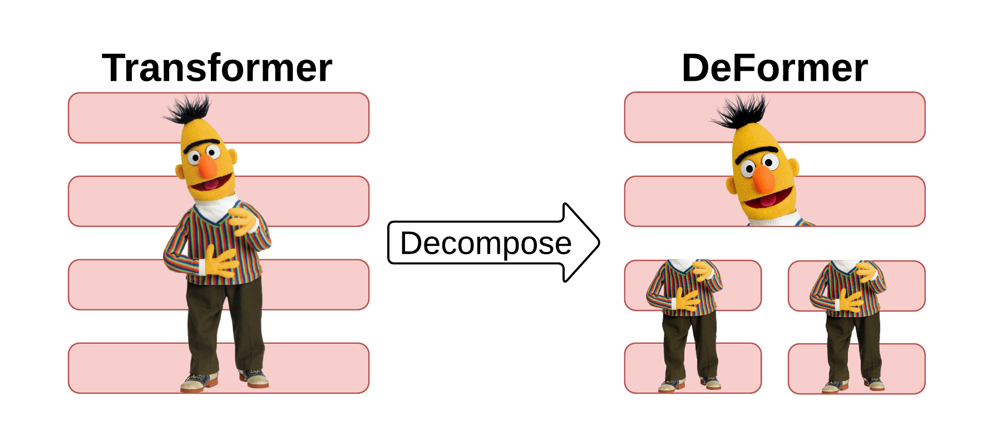





DeFormer: Decomposing Pre-trained Transformers for Faster Question Answering
Qingqing
Cao
Harsh
Trivedi
Aruna
Balasubramanian
Niranjan
Balasubramanian
Notes:
Hello everyone! I’m Qingqing Cao, a PhD student from Stony Brook University. Today, I’m going to talk about DeFormer: Decomposing Pre-trained Transformers for Faster Question Answering, this is a joint work with Harsh, Aruna, and Niranjan.

Slide 2


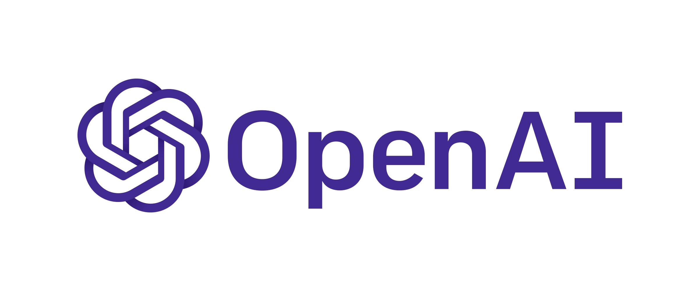


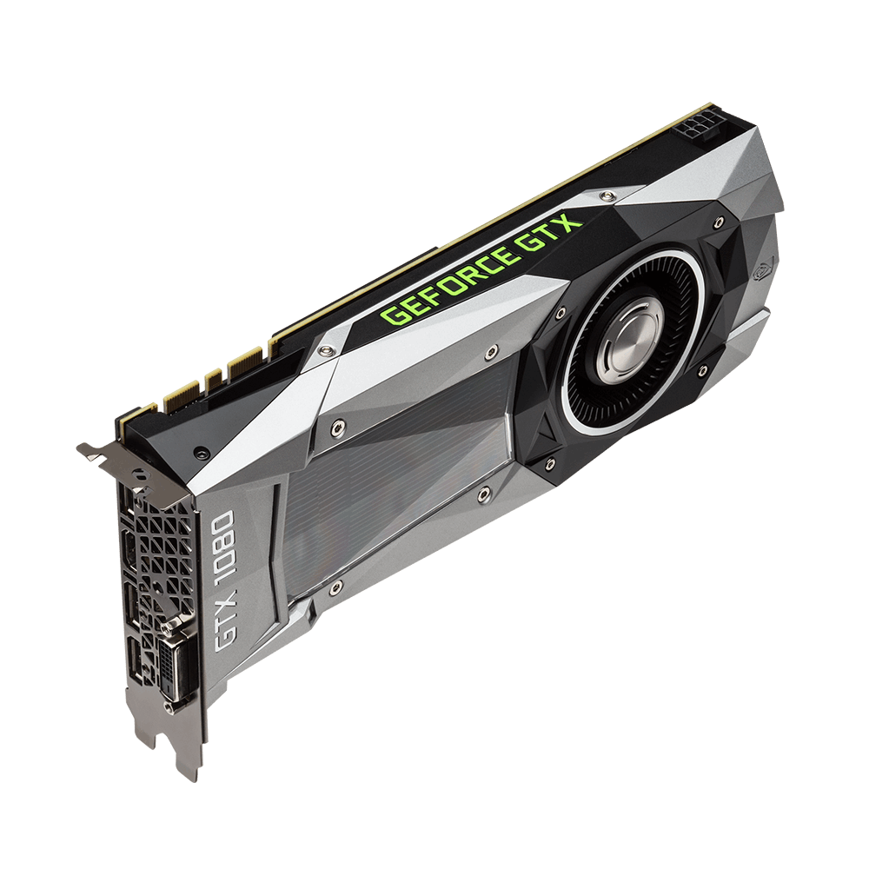
Resource Challenges in Large Transformers
BERT-Large
340 M
RoBERTa-Large
355 M
GPT-2
1.5 B
T5
11B
Megatron
8.3 B
increasing model size
High runtime latency
High runtime memory
10 s to answer a question!
> half GB to run one question
Notes:
In recent years, big Transformer models have gained huge success for many NLP tasks. However, the models are growing larger and larger, which cause significant resource challenges in deployment.
There are two major problems for these big models.
First, the runtime latency is high due to large amounts of computation. For example, on a flagship smartphone, it takes as much as 10s to answer just one question using a BERT QA model.
Second, inference in big models lead to high runtime memory footprint. For instance, running a BERT QA model on a GPU consumes >half GB of memory for one question.

Slide 3
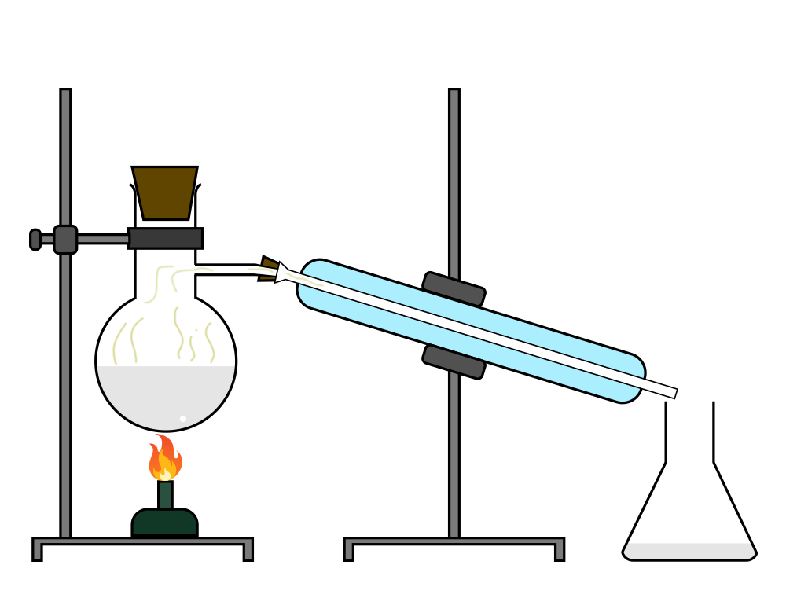



How to Reduce Runtime Latency and Memory?
expensive pre-training 😟
Distillation
DistillBERT, TinyBERT ...
✘
orthogonal approach
to run faster?
no pre-training 😀
Notes:
So how can we reduce the runtime latency and memory footprint? One approach is to use compression techniques to make big models smaller. For example, you can use distillation to transfer knowledge from the big models to smaller ones. Recent examples include DistillBERT and TinyBERT.
However, this approach often requires expensive pre-training of the smaller models before fine-tuning.
Instead, we want to ask: is there an orthogonal approach to run models faster but avoid repeated pre-training?
Before we answer the question, let’s understand why Transformers are slow for QA tasks

Slide 4
Why are Transformers Slow for QA?
Predicted Answer
Layer n
Context is much longer than the question
Layer 2
Context processing is the bottleneck in all layers
Layer 1
Q
Context
x
> 10x
Notes:
Given a question and a context passage, a Transformer model first concatenates their embeddings together, then it applies full self attention over the entire sequence, and repeats this process through multiply layers.
Here we note two important things: first, the context is often much longer than the question, therefore, the building context representations dominates the computation in the layer.
Second, the context computation bottleneck exists in all the layers.

Slide 5
How Can We Reduce the Context Bottleneck?
Predicted Answer
question dependence
Layer n
Layer 2
compute offline?
Layer 1
How much of this question dependence is necessary?
Q
Context
runtime
available offline
Notes:
So how can we reduce this context bottleneck?
If we somehow eliminate having to compute context representations during runtime then we can remove this bottleneck entirely.
In fact this is doable because in most QA settings the context is available to us offline. It is the question that arrives runtime.
If we can compute these representations in an offline manner, then we can save big.
We do know that processing the context should depend on the question.
But we can ask: how much of this question dependence is necessary? For example, do we need this in all layers?

Slide 6
How critical is question dependence?
layer k
Q1
Context
Q2
Context
High question dependence
Notes:
Let’s consider a question and its context processed through some self-attention layer k.
Suppose in this layer the context representations depend on the question.
This means if we change the question then the context representations should change.
So if we use a different question Q2 and the context representations vary a lot, then the question dependence is high.

Slide 7
How critical is question dependence?
layer k
Q1
Context
Q3
Context
Less question dependence
Notes:
Conversely, if the question dependence is low, a different question won’t change the context representations too much.
For example, for a question Q3, if the context representations are similar, there is less question dependence.

Slide 8
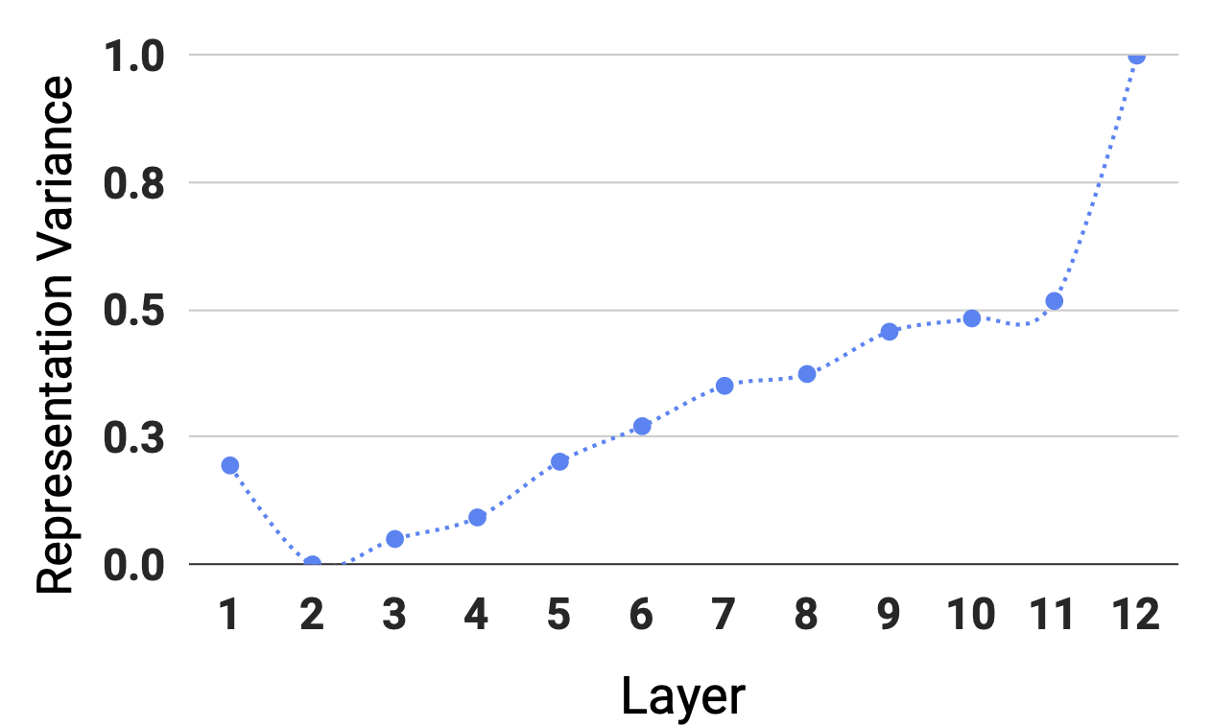
Question Dependence in Different Layers
Representation Variance
Question dependence is less in the lower layers!
Notes:
We measure the question dependence for each layer as how the context representations change for different questions.
And compute an average metric called representation variance at.
This plots shows the value of this measure for different layers in BERT base model.
Higher values in y-axis mean higher dependence and vice versa.
You can see the variance is much smaller in the lower layers compared to upper layers, which says context representations are less dependent on the question in the lower layers.
This means, in the lower layers we can get away with processing the context independent of the question.

Slide 9

Decomposing the Dependence in Lower Layers
Layer n
DeFormer = Decomposed Transformer
Layer k+1
save
Layer k
offline
runtime
context representations
Layer 1
look-up
Q
Context
Notes:
Which is to say, we can decompose the dependence in lower layers.
In particular, given a question and a context, in the lower layers, we apply self-attention over the question and the context individually.
The context processing now can be pushed offline, and we save the context representations from the layer k.
In the runtime, we can just look up the k-th layer context representations we saved, and join them with the k-th layer question representations, and process them together at upper layers as the same as the original model.
In this way, the upper layers can still create effective question and context representations by applying full self-attention as before.
We call this approach as DeFormer which stands for decomposed Transformer.
Note that Deformer only makes minimal changes to the Transformer, which means we can reuse the pre-trained Transformer weights, and requires no additional pre-training.
DeFormer can effectively speedup the inference as we will show later in the experiments. But the speedup comes with model accuracy loss due to missing information in the lower layers.

Slide 10
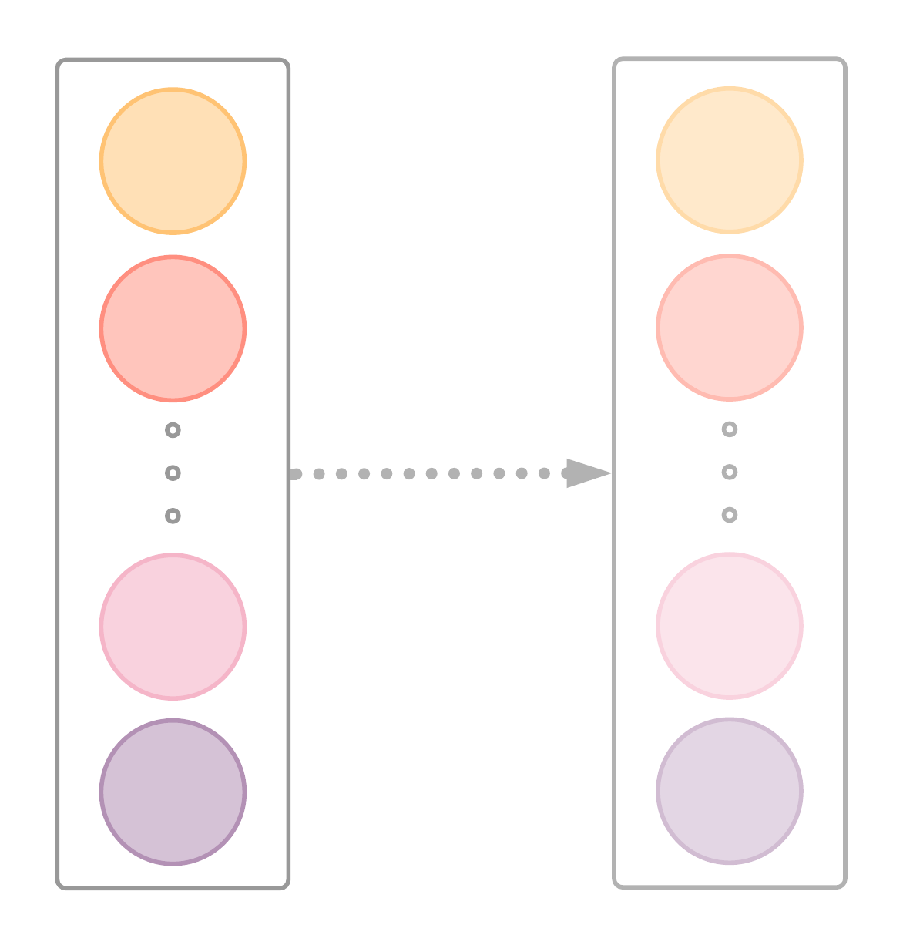
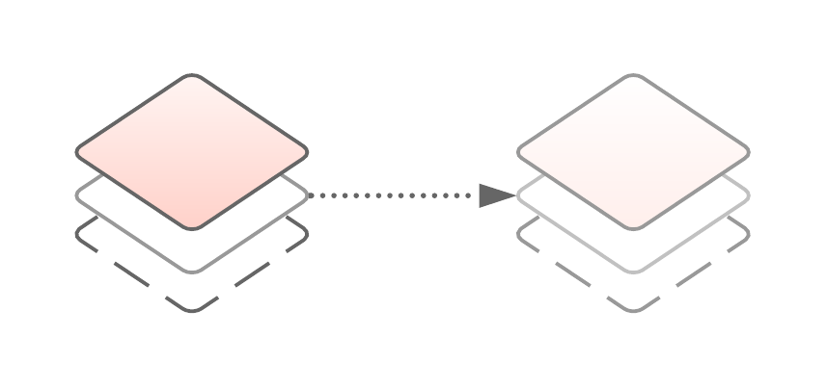
Fine-tuning DeFormer with Auxiliary Supervision
Layer n
KD^
Layer k+1
LRS*
Layer k
Transformer
DeFormer
^knowledge distillation
*layerwise representation similarity
Notes:
To compensate for the loss, we apply auxiliary supervision to DeFormer during fine-tuning.
We want DeFormer to behave more like the original Transformer, especially for the upper layers. If the upper layer information of the two models are similar, the answer predictions should be similar. The key difference is the information in layer k+1 and following layers.
The auxiliary supervision is done by applying two losses during fine-tuning:
the first loss is to enforce layerwise representation similarity of the upper layers between DeFormer and the original Transformer, we minimize the token representation distance of the upper layers of the two models.
To further make the answer predictions close to the original Transformer, we add a knowledge distillation loss to learn the logits from the original Transformer.
Note that this auxiliary supervision is used only during fine-tuning. We don’t need to repeat pre-training again.
Now I’d like to answer the following questions to evaluate DeFormer.

Slide 11
Evaluation
How effective is DeFormer in latency, memory and accuracy?
What is the impact of auxiliary supervision?
What is the efficiency tradeoff at different layers?
Notes:
First, How effective is DeFormer in latency, memory and accuracy?

Slide 12
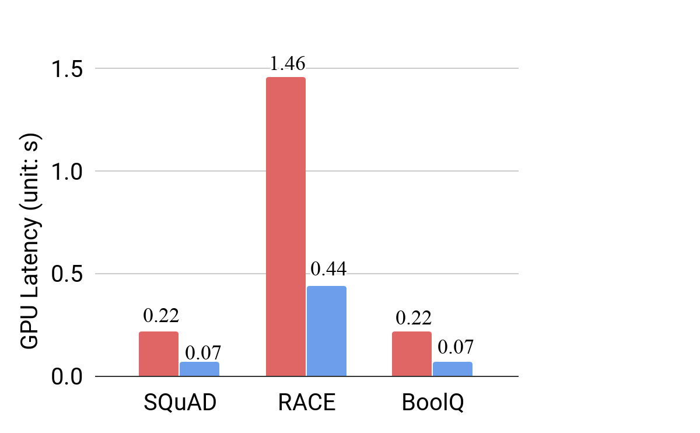
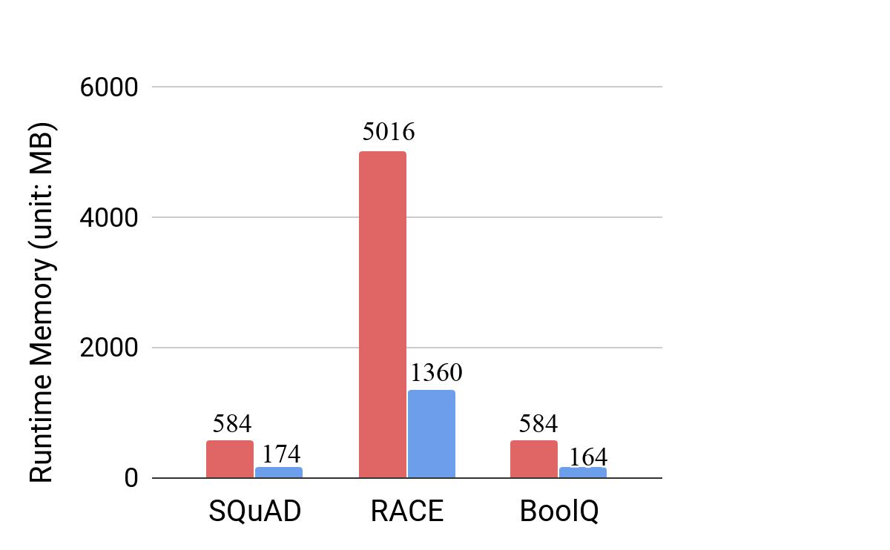
DeFormer is Faster and Memory Efficient
BERT-base
DeFormer-BERT-base
3x reduction in runtime latency
70% reduction in runtime memory
Notes:
We measured the inference latency of running BERT-base model on the GPU with batch size 32, and compare with DeFormer version for 3 QA datasets: SQuAD, RACE, BoolQ.
As you can see, DeFormer can effectively reduce runtime latency by over 3x. We also measured the runtime memory consumption accordingly. Using DeFormer can reduce more than 70% of runtime memory footprint.
So, what about the actual performance on the devices?

Slide 13
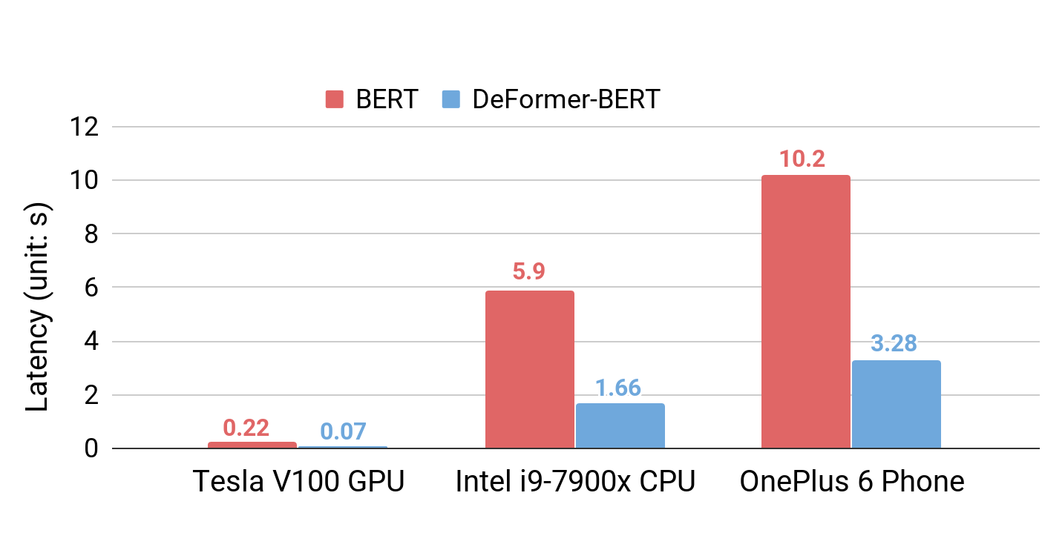

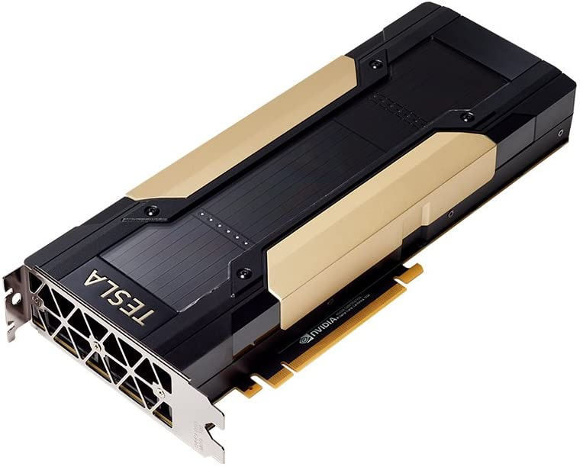
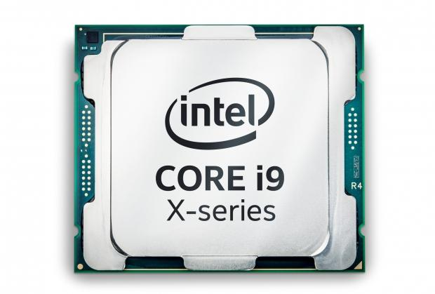
DeFormer Gains Speedup on Diverse Devices
more usable
process more questions
3x faster
Notes:
We tested inference latency for 3 hardware devices: a datacenter GPU, desktop CPU and a mobile phone. As the figure shows, DeFormer indeed gains >3x speedup for all devices.
On the mobile phone, DeFormer can reduce the latency from 10s to 3s, making a QA system more in the usable range.
In fact, the speedup is coupled with memory reduction, which enables large volume deployments by allowing processing more questions simultaneously and faster.

Slide 14
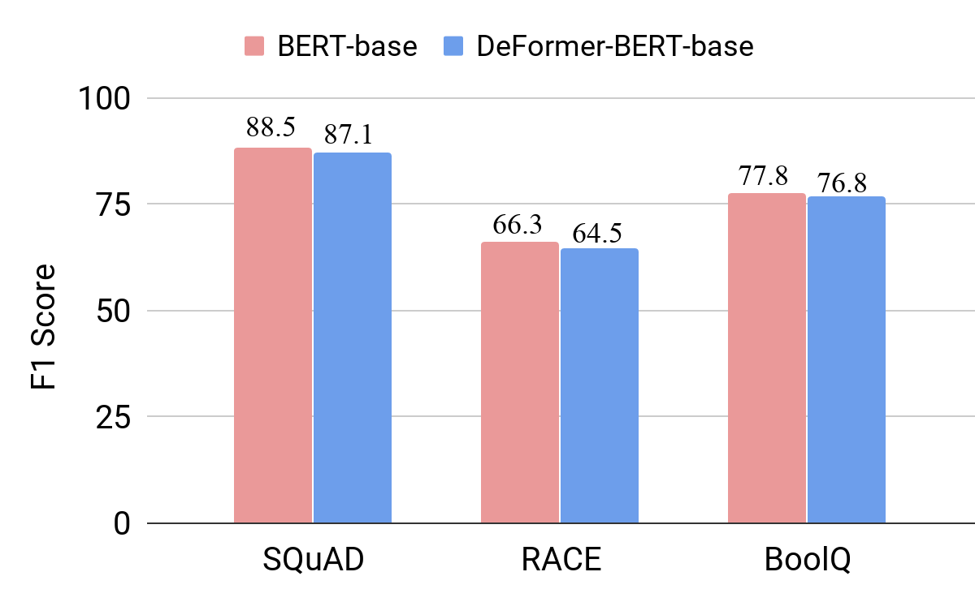
DeFormer (Mostly) Retains Original Performance
DeFormer retains 98% of the original model’s performance
Notes:
As for the model’s performance, this figure presents the F1 score of both the original BERT-base model and the DeFormer version.
DeFormer gives similar F1 scores to the original model, and can retain up to 98% of the original model’s performance.
We also conducted similar experiments for XLNet which gives similar results, please refer to the paper for more details.

Slide 15
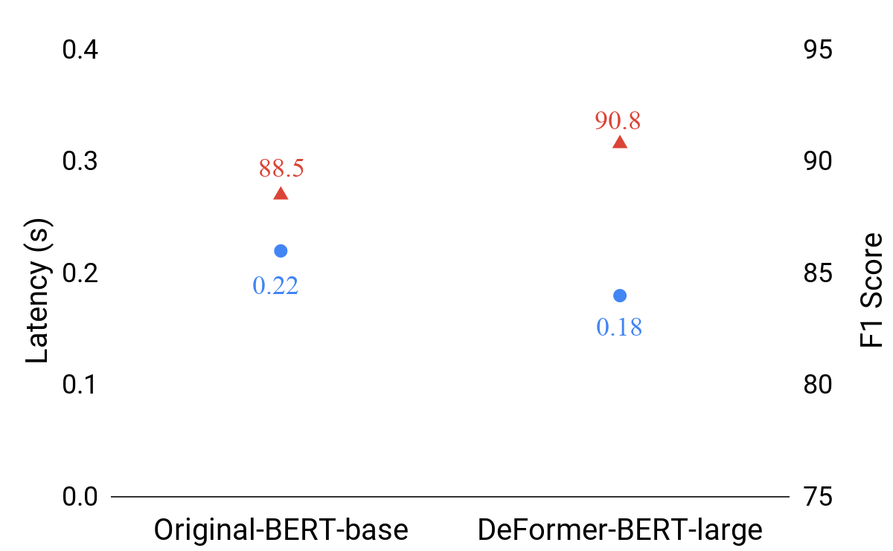
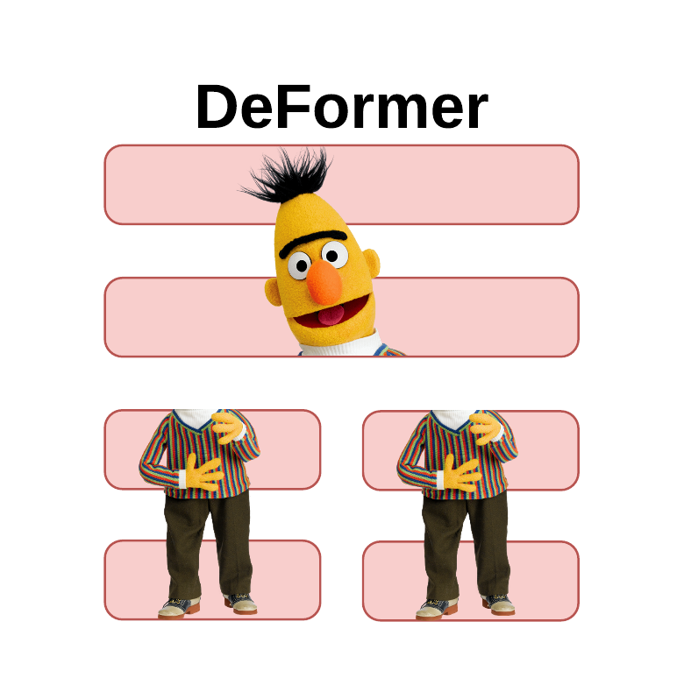
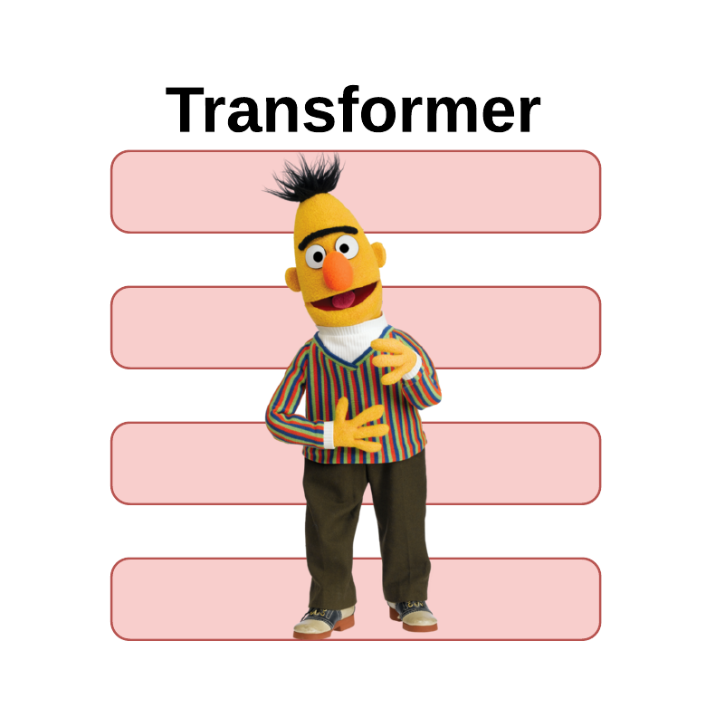
A Large DeFormer is Faster and More Accurate than a Smaller Transformer
3% more accurate
F1 Score
Latency (seconds)
runs 18% faster
Original-BERT-base
DeFormer-BERT-large
Notes:
Interestingly, we found that DeFormer can make large models run faster while being more accurate than smaller ones.
Specifically, we compared the original BERT-base model with DeFormer large one.
We measured the inference latency and found DeFormer makes BERT large 18% faster than BERT base
We also evaluated the F1 score of both models, and found that DeFormer BERT large is still 3% more accurate.
This potentially indicates that it might not be necessary to compress big model to run faster.

Slide 16
Evaluation
How effective is DeFormer in latency, memory and accuracy?
What is the impact of auxiliary supervision?
What is the efficiency tradeoff at different layers?
Notes:
Next, we want to ask “what is the impact of auxiliary supervision?” Remember that there are two components: layerwise representation similarity and knowledge distillation.

Slide 17
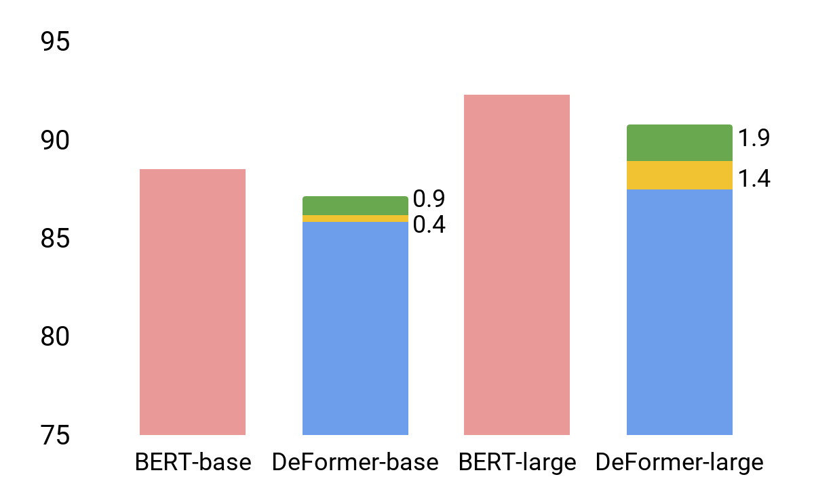
LRS and KD both Provide Benefits in DeFormer
Layerwise Representation Similarity
Knowledge Distillation
92.3
90.8
88.5
87.1
87.5
F1 Score
85.7
Notes:
To understand the impact, we did an ablation analysis of DeFormer for the BERT-base and large model on the SQuAD dataset.
For the base model, DeFormer incurs 2.8 points drop in F1 Score, adding knowledge distillation provides 0.4 improvement, and layerwise representation similarity gives an additional 0.9 improvement. Combining them helps close the F1 score gap to 1.4.
For BERT-large model, DeFormer without any auxiliary supervision shows 4.8 drop. But both knowledge distillation and layerwise representation similarity gives over 1 point improvement, and together they close the gap to 1.5.

Slide 18
Evaluation
How effective is DeFormer in latency, memory and accuracy?
What is the impact of auxiliary supervision?
What is the efficiency tradeoff at different layers?
Notes:
In DeFormer, it’s also important to decide where the decomposition happens. We want to ask “What is the efficiency tradeoff at different layers?”

Slide 19
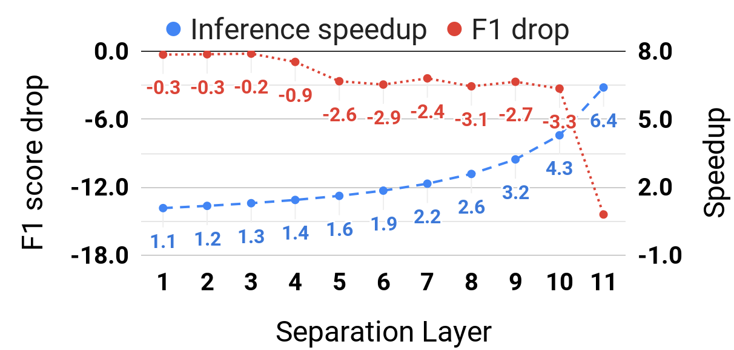
Which Layer to Decompose?
less dependence, less performance impact
good tradeoff points
Notes:
To answer this question, we conducted an experiment to understand the model performance drop versus speedup and show the tradeoff here.
This Figure is for BERT base model, the red dotted line shows F1 score at each layer.
Note that the first few lower layers, the scores only drop a bit. This is verifies our previous argument that lower layer has less dependence and thus removing the dependence won’t affect model performance too much.
The blue dotted line shows speedup. Decomposing at upper layers gives more speedup but sacrifices more performance.
Layer 9 or 10 would be good starting points for decomposition depending on the actual task.
DeFormer also allows fine-tuning by choosing different layers to decompose.

Slide 20
Takeaways
DeFormer uses a simple decomposition technique that significantly speeds up inference, reduces memory while retaining most of the model’s accuracy
DeFormer leverages distillation along with auxiliary supervision to reduce performance gap to the original Transformer
KD
+
LRS
DeFormer remains largely the same as the Transformer, allowing reusing original model weights without repeating pre-training
✘
Notes:
Lastly, I’d like to conclude the talk with the following takeaways:
The main idea of DeFormer is the use of a simple decompose technique, ...
Additionally, ...
Importantly, ...

